Slide 1
Integrated Diabetes Solution App Using AI
Group 6
조한서(2022041012) 김유빈(2022078066) 성동현(2020039081)
고건영(2020017027) 박성애(2022041078)

Slide 2

Development Purpose/Definition
Given the rising number of diabetics today,
We aim to create user-friendly tools that assist with diabetes management
Our integrated app offers comprehensive solutions tailored for diabetic
Easy diet control for individuals through image learning through AI
Access apps anytime, anywhere with a database

Slide 3
Contents
Introducing Team Member
Key Features
Ai camera
Alarm
a blood sugar notebook
Collect
Profile
Practice

Slide 4

Introducing Team Members
Group Leader: 조한서
- Blood sugar notebook function, user interface implementation
김유빈
Log-in, membership implementation, overall UI design, DB linkage
고건영
- Data preprocessing, AI model learning and attachment, camera functionality, blood sugar visualization functionality
성동현
- User interface implementation, alarm and collection capabilities, code stability

Slide 5
Key Features

Slide 6
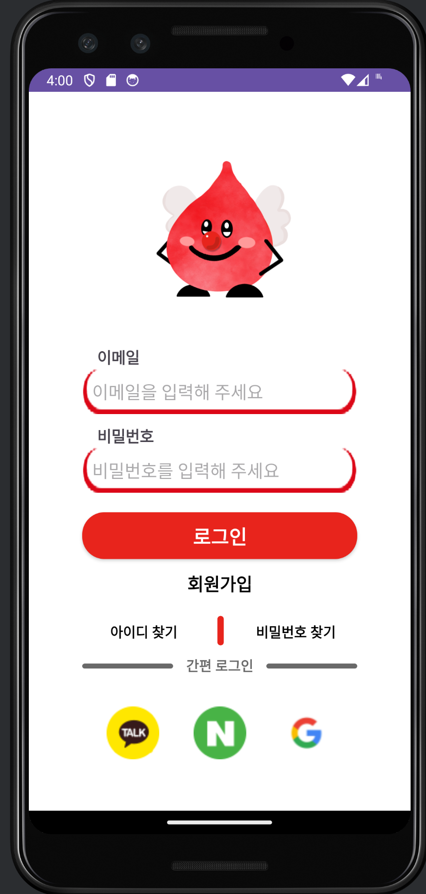
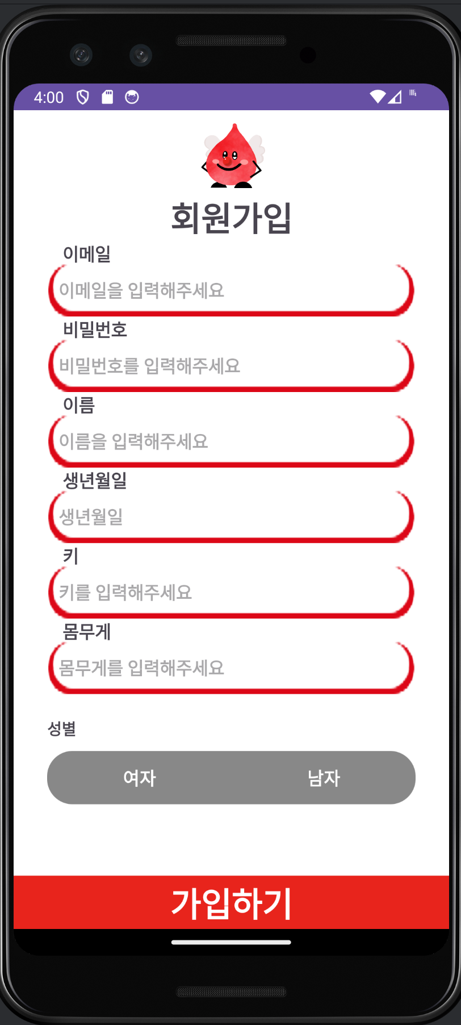
Sign-in, membership screen
Once logged in, automatically skipped the next run
Error window when entering incorrect data

Slide 7
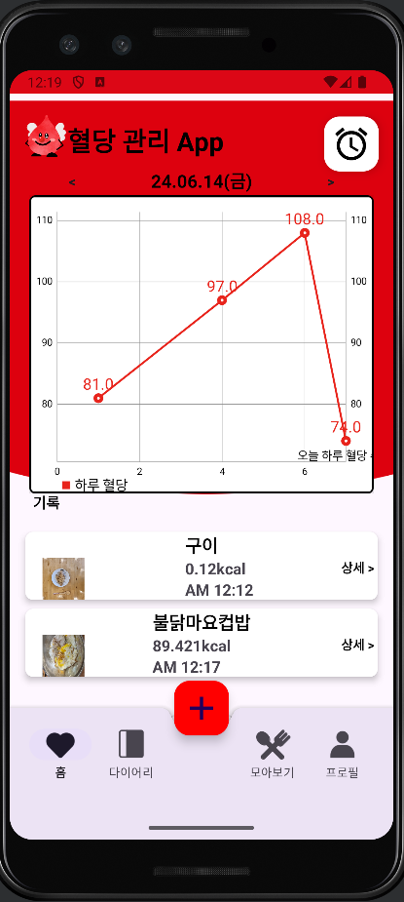
Main Screen - Home
Visualize blood sugar trends through graphs
Take a picture through the '+' button in the middle and analyze it with AI
Alarm button at the top right

Slide 8
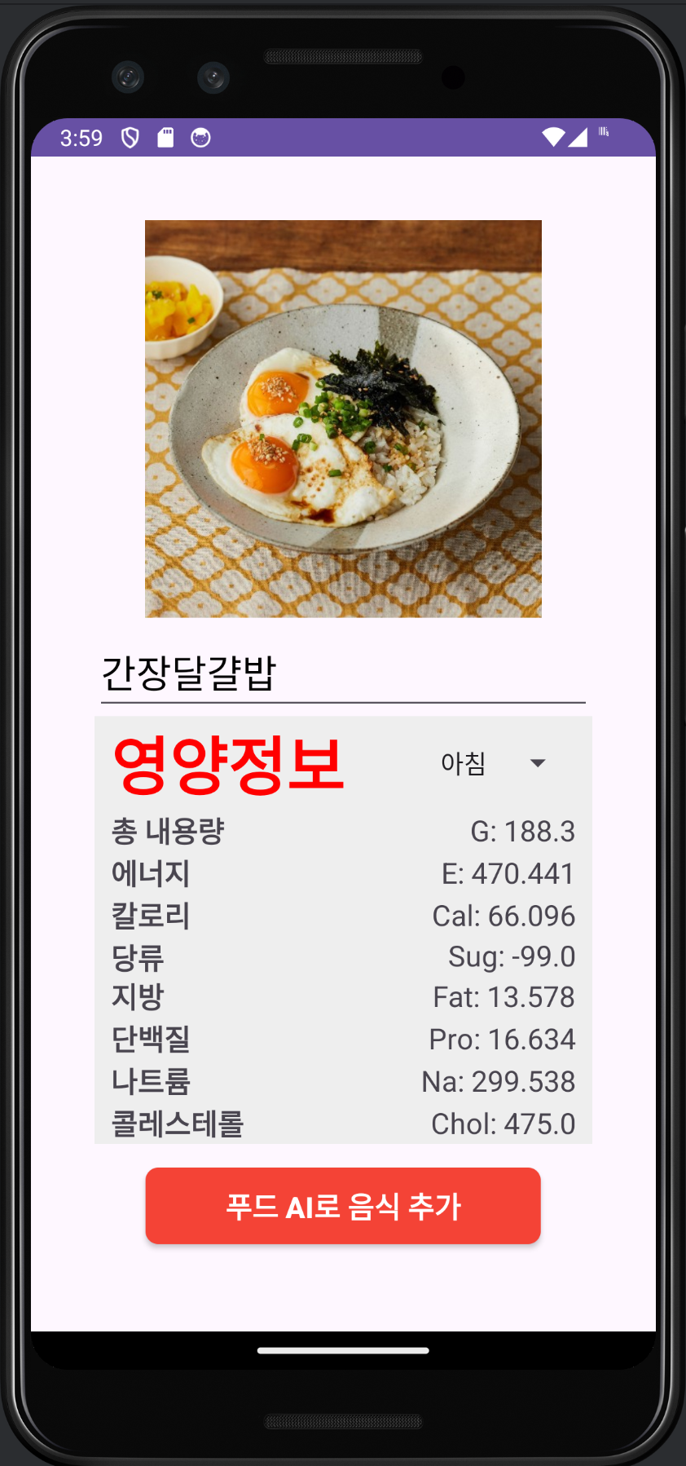
Check the results of the camera AI prediction
Analyzing the food in the picture taken through AI
Add the name and date of the picture taken to the database

Slide 9
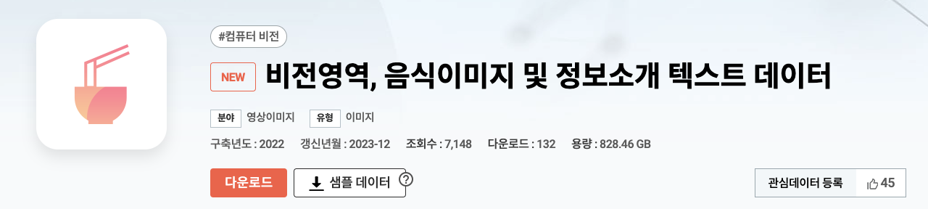

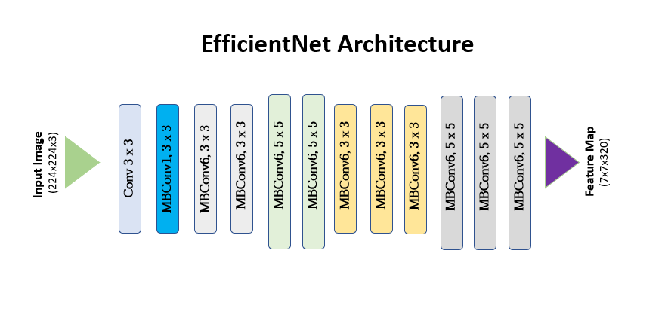
Collecting data

Slide 10
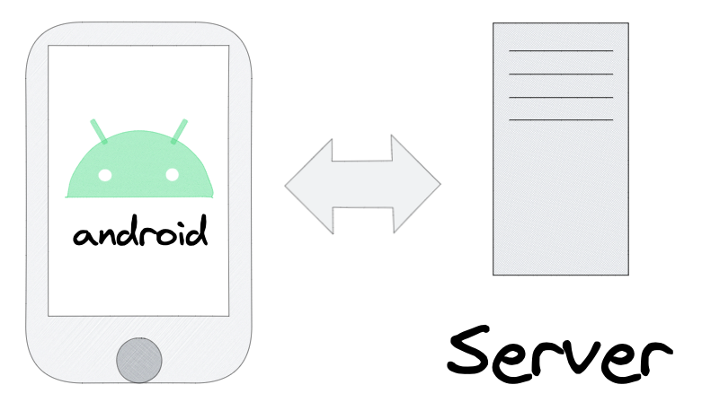

Model Deployment Methods
VS

Slide 11
Select a model
Model Performance
Low computational cost
4~5days

Slide 12
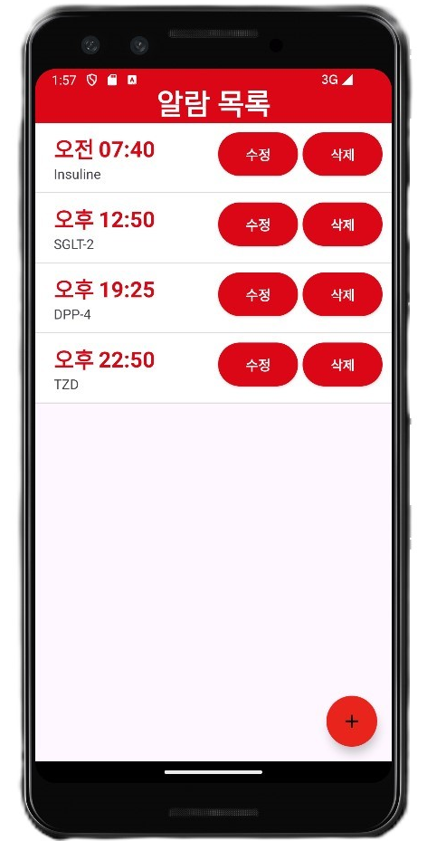
Alarm Screen – Alarm
Create an alarm via the bottom right button
Each alarm can be deleted/modified

Slide 13
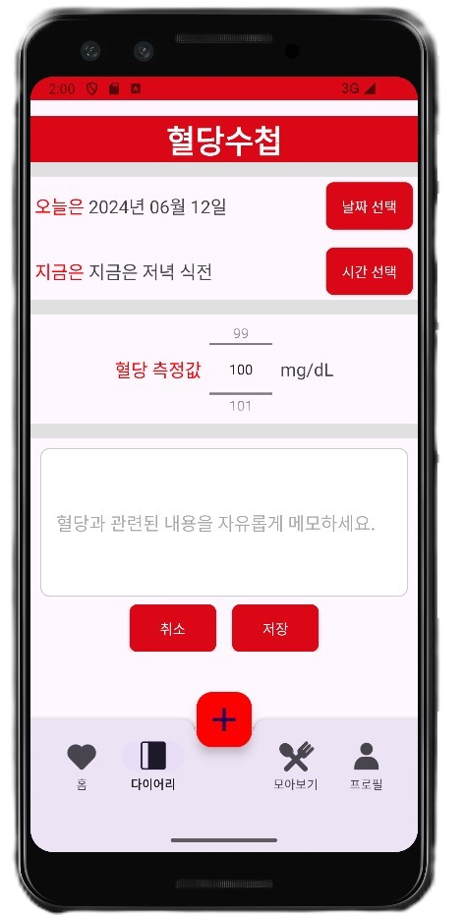
Blood Sugar Notebook - Diary
The ability to store the time, date, blood sugar, and simple notes

Slide 14
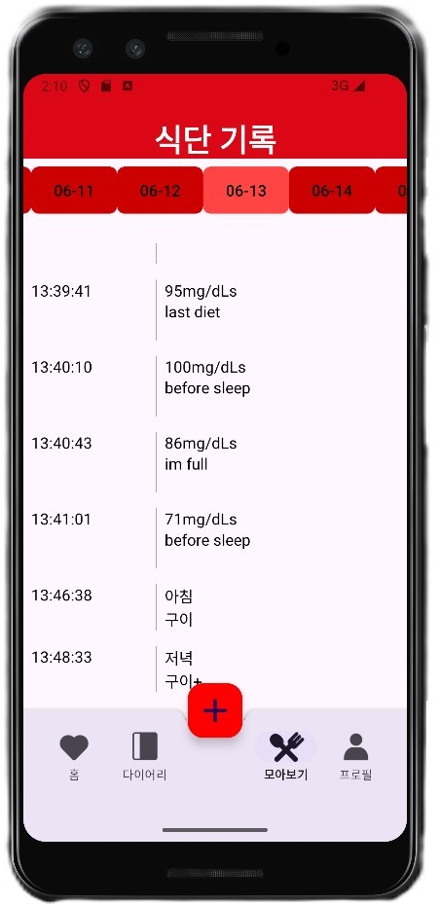
View full results - Collect
diet and date output
Blood sugar and note output
Sort by date first, and then by time in ascending order.

Slide 15
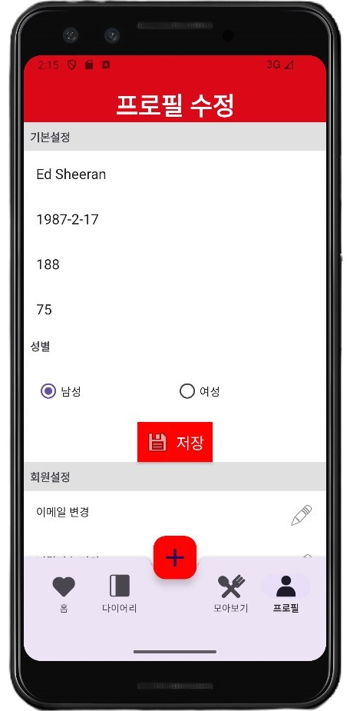
Profile Screen - Profiles
Functional to modify data you created by default
Membership Withdrawal
Sign out
Email and Password change

Slide 16
Practice

